Slide 1
IT 106: Introduction to IT Problem Solving Using Computer Programming
Module 3b
Implementation of Selection Control Structures and Decision Statements

Slide 2
In This Lecture
Creating IF Statements
Comparing Numbers and Strings
Solving Problems Using IF Statements

Slide 3
Questions?

Slide 4
Creating IF Statements

Slide 5
Recap: Simple Selection With IF Statements
Selection statements are used when a decision needs to be made based on a condition
Selection statements can be created using IF statements
The evaluation of the condition returns a boolean (true or false)
Pseudocode Example
IF account_balance < $300 THEN
service_charge = $5.00
ELSE
service_charge = $2.00
END IF

Slide 6
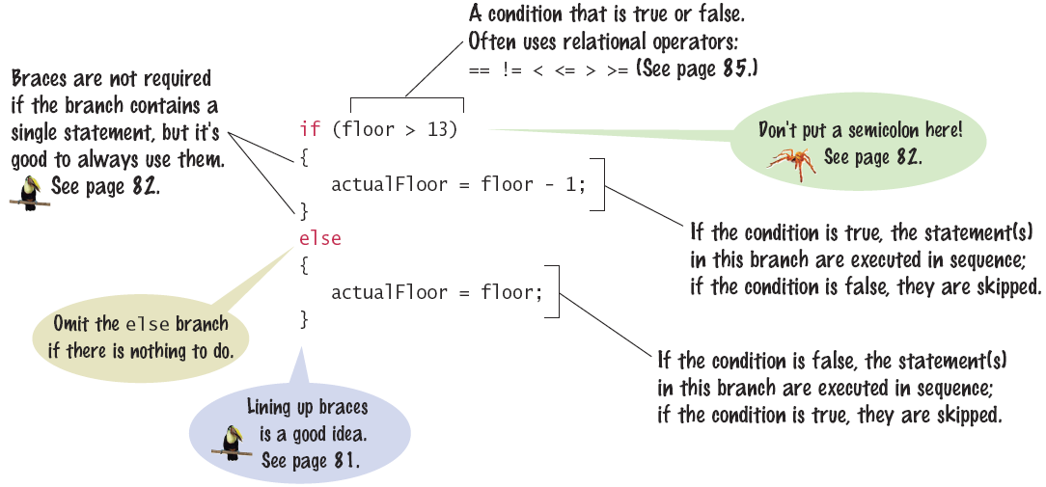
Syntax: The IF Statement

Slide 7
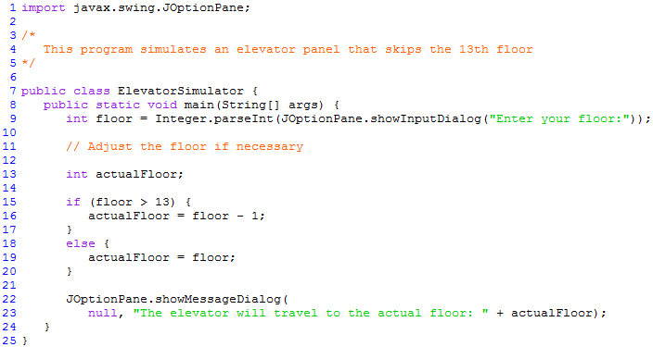
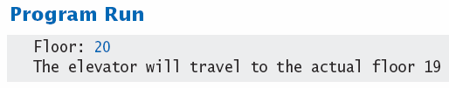
Example: IF Statement

Slide 8



Ways to Denote Braces
Line up all pairs of braces
Most IDEs have the ability to automatically align matching braces
Always use braces
Although single statement clauses do not require them, you should always include them

Slide 9
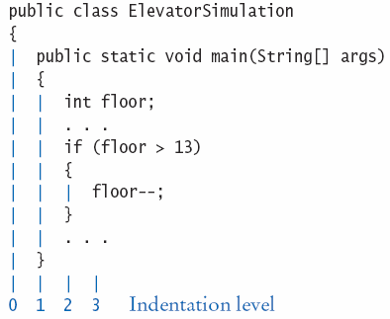
Tips on Indenting Blocks
Use tab to indent a consistent number of spaces
This is referred to as ‘block- structured’ code. Indenting consistently makes code much easier for humans to follow.

Slide 10
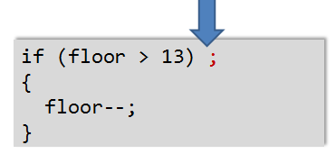
Common Error: Misplaced Semicolon
It is easy to make a mistake and include a semicolon at the beginning of an if statement
The TRUE condition would now be the space just before the semicolon, which is empty. Nothing would execute and orphan braces are a logic error
Logic Error!

Slide 11
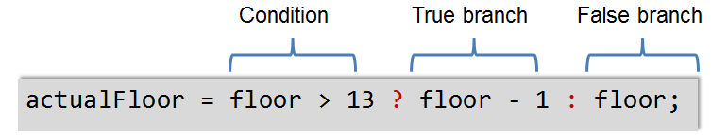
The Conditional (Ternary) Operator
Shortcut used to denote an IF control structure
Includes all parts of an if/else clause, but uses
? To begin the true branch
: To end the true branch and start the false branch

Slide 12
Questions?

Slide 13
Comparing Numbers and Strings

Slide 14
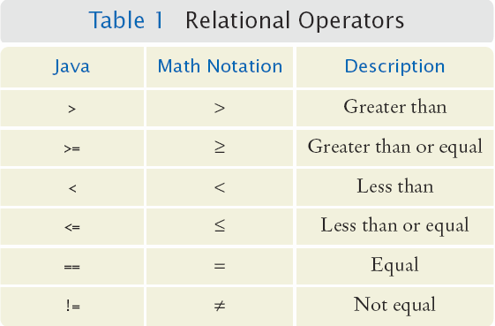
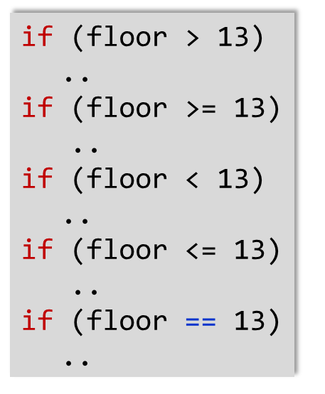
Comparing Numbers
Every IF statement has a condition
Usually compares two values with an operator
Beware!

Slide 15
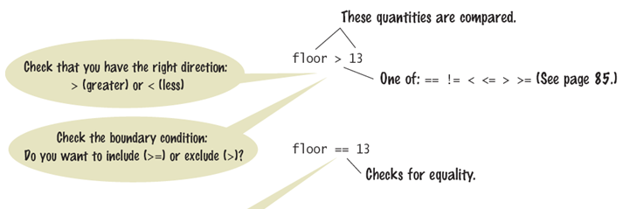
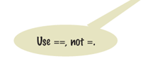
Syntax: Numerical Comparisons

Slide 16
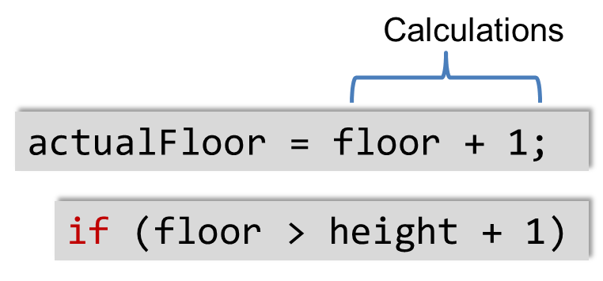
Operator Precedence
Comparison operators, such as: < and > have a lower precedence than arithmetic operators
Calculations are done before the comparison
Normally, calculations are on the "right side" of the comparison or assignment operator (=)

Slide 17
Comparing Strings
Strings are a bit "special" in Java
You cannot use == to compare Strings
Using == compares the memory locations, instead
Use the String's equals method

Slide 18
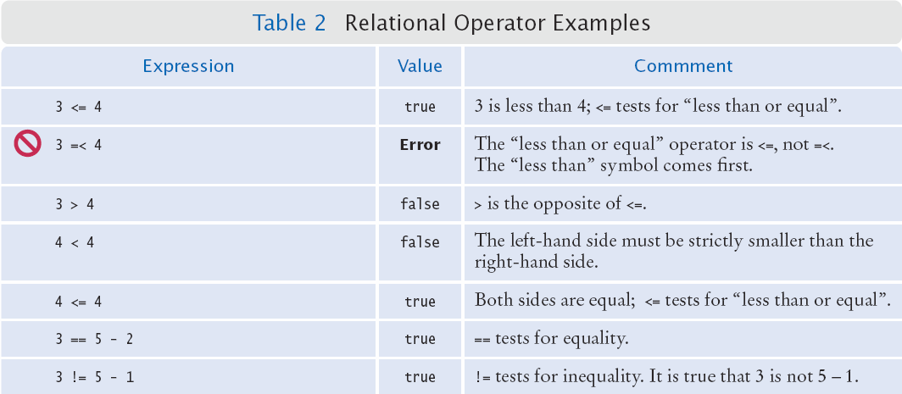
Relational Operator Use Examples

Slide 19
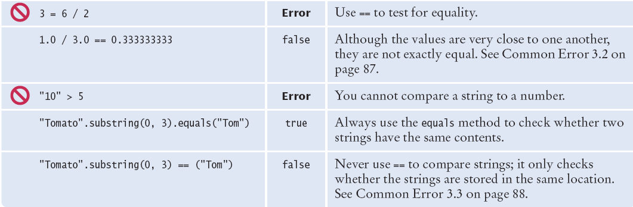
Relational Operator Use Examples (Cont'd)

Slide 20
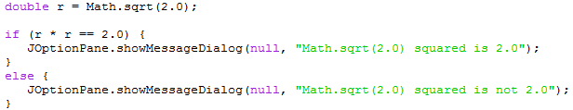
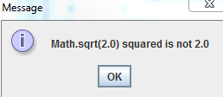
Comparing Floating-Point Numbers
Floating-point numbers have limited precision
Round-off errors can lead to unexpected results
Math.sqrt(2.0) squared is not 2.0 but 2.00000000000000044

Slide 21

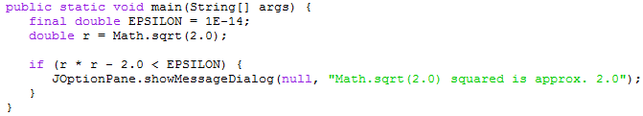
Using EPSILON to Compare Numbers
Since the precision of floating-point numbers is limited, we can create a small value (EPSILON) to help see if the numbers are "close enough"
The magnitude of difference is based on the type of comparison needed
Mathematically, the equation would look like this
Testing within 14 decimal places

Slide 22
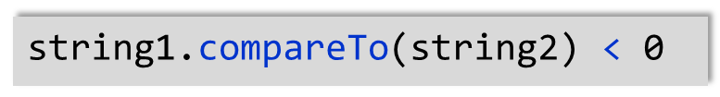


Lexicographical Order
To compare Strings in "dictionary" order
When compared using comparedTo, string1 comes:
Before string2 if
After string2 if
Equal to string2 if
Notes:
All UPPERCASE letters come before lowercase
"space" comes before all other printable characters
Digits (0-9) come before all letters

Slide 23
Questions?

Slide 24
Solving Problems Using IF Statements

Slide 25


Implementing an IF Statement
Decide on a branching condition
Write pseudocode for the true branch
Write pseudocode for the false branch
Double-check relational operators
Test values below, at, and above the comparison (127, 128, 129)
Remove duplication
Test both branches
Write the code in Java

Slide 26
Implemented Example
The university bookstore has a Kilobyte Day sale every October 24, giving an 8 percent discount on all computer accessory purchases if the price is less than $128, and a 16 percent discount if the price is at least $128.
if (originalPrice < 128) {
discountRate = 0.92;
}
else {
discountRate = 0.84;
}
discountedPrice = discountRate * originalPrice;

Slide 27
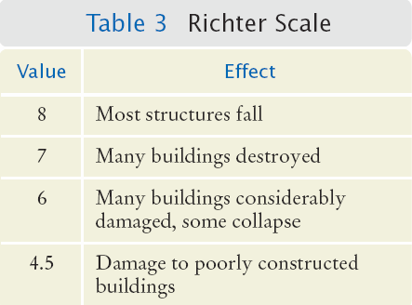
Multiway Branching
Used when there are more than two available decision branches, such as for the Richter scale:
8 (or greater)
7 to 7.99
6 to 6.99
4.5 to 5.99
Less than 4.5

Slide 28
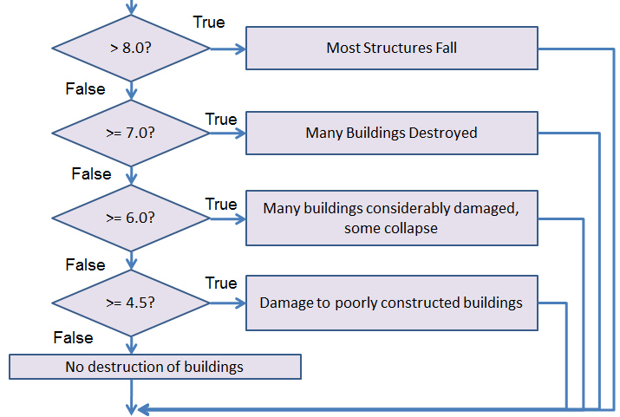
Flowchart of Multiway Branching

Slide 29
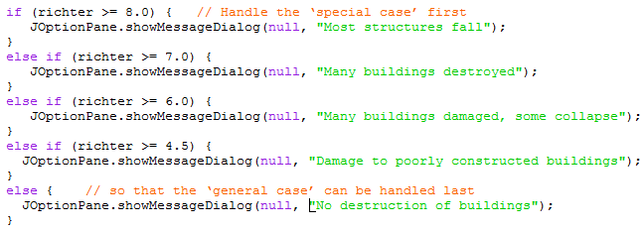
If/Else If Multiway Branching
When using multiway branching, only one branch will be selected

Slide 30
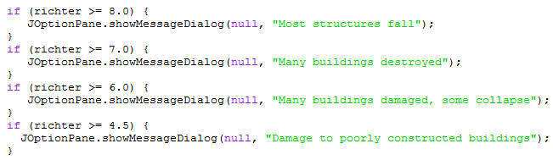
Question
What is wrong with this code?

Slide 31
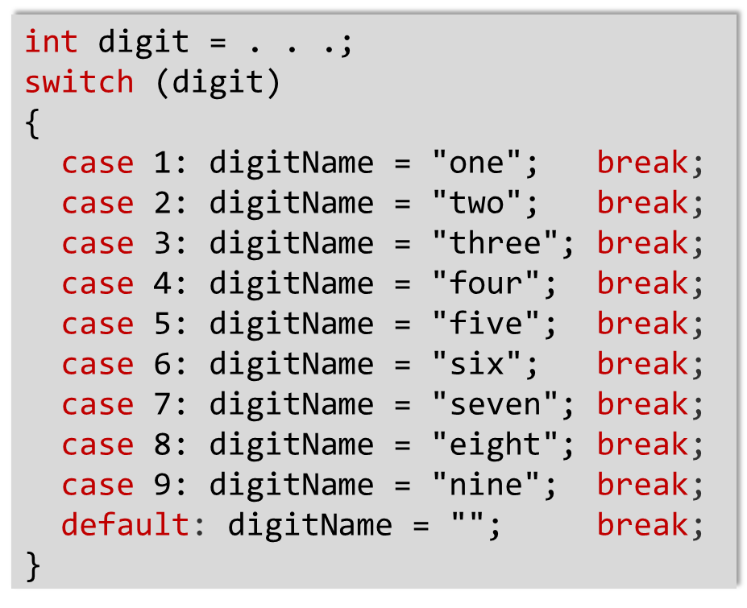
Using CASE to Multiway Branch
The switch statement choose a case based on an integer value
break ends each case
default catches all other values
If the break is missing, the case falls through to the next case’s statements.

Slide 32
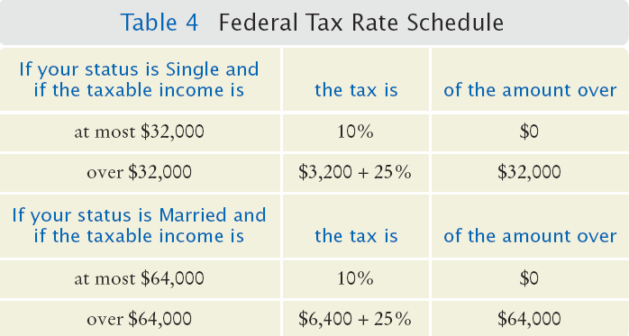
Nested IF Example: Calculating Taxes
Four outcomes
Single
<= $32,000
> $32,000
Married
<= $64,000
> $64,000

Slide 33
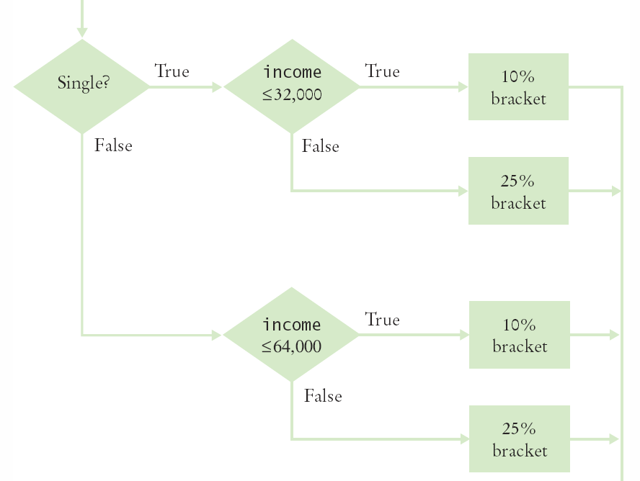
Flowchart for Tax Example

Slide 34
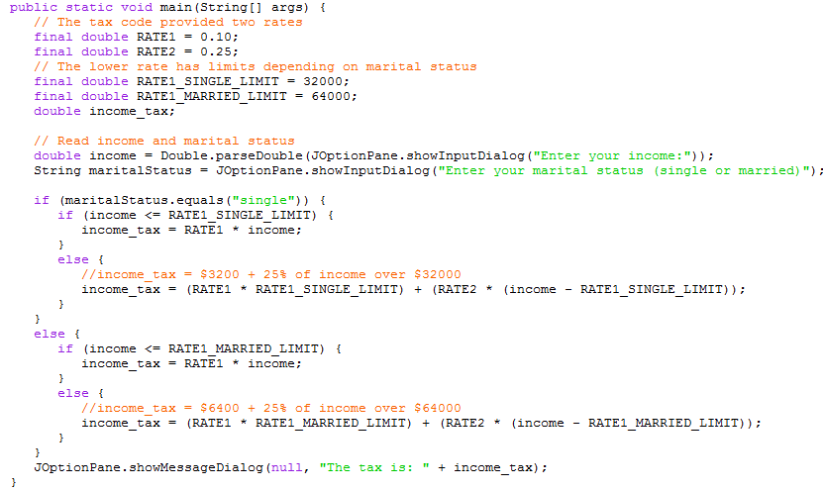
Completed Java Program for Tax Example

Slide 35
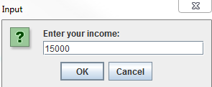
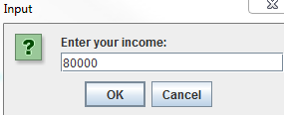
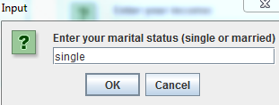
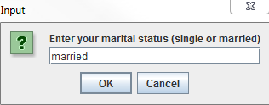
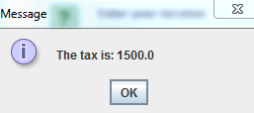
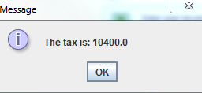
Completed Java Program for Tax Example (Cont'd)

Slide 36
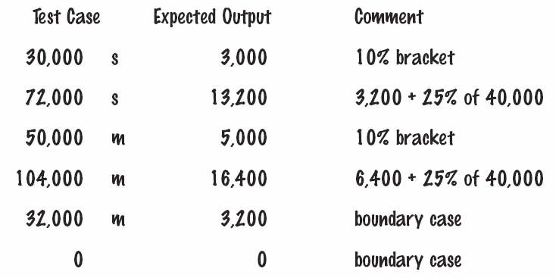
Choosing Test Cases
A boundary case is a value that is tested in the code.
Choose input values that:
Test boundary cases and 0 values

Slide 37
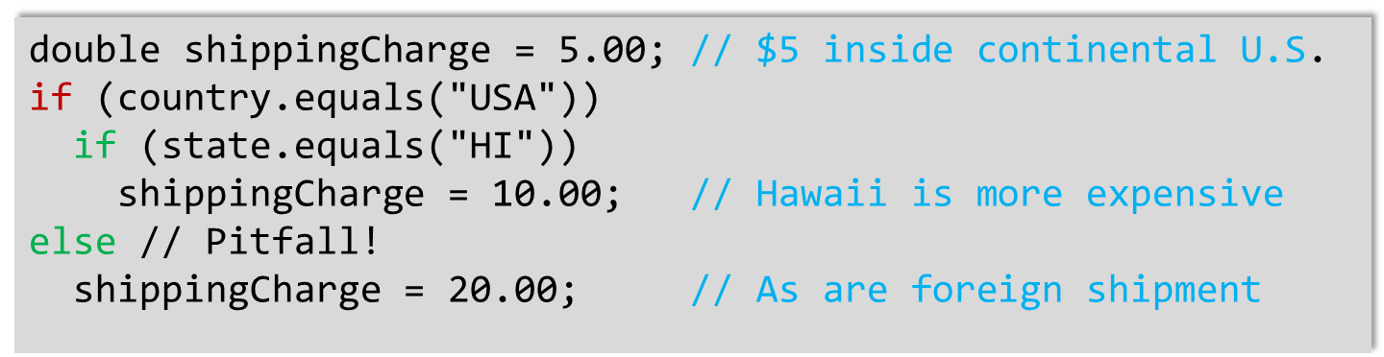
Common Error: Dangling Else Problem
When an if statement is nested inside another if statement, errors can occur without proper {}
The indentation suggests the else is related to the if country("USA")
Else clause is always associated to the closest if
Missing {. Would solve problem

Slide 38
Boolean Variables and Operators
Boolean variables are often called flags because they can either be up (true) or down (false)
Think of a light switch
boolean is a Java data type
Boolean operators: &&, | |, and !
&& is the and operator
|| is the or operator
! (not) is used to invert a boolean value

Slide 39
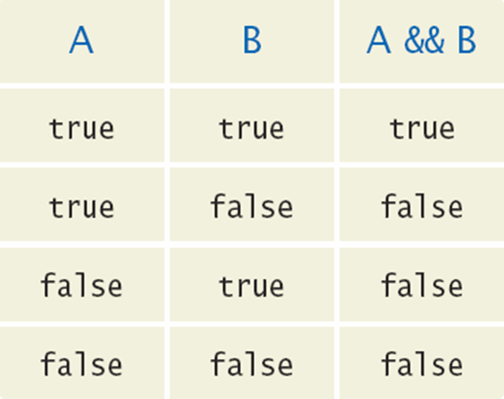
Combined Conditions: &&
Combining two conditions is often used in range checking
Is a value between two other values?
Both sides of the and must be true for the result to be true
if (temp > 0 && temp < 100) {
state = "Liquid";
}

Slide 40
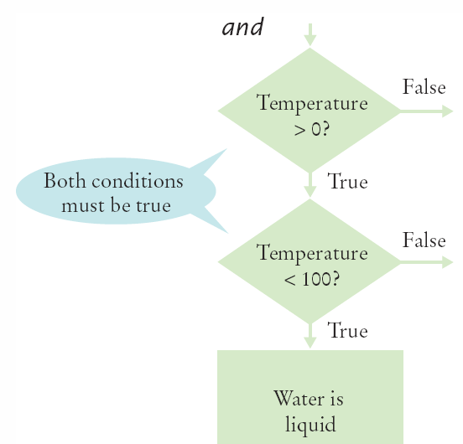
Flowchart Using AND
if (temp > 0 && temp < 100) {
state = "Liquid";
}

Slide 41
Lazy Evaluation: &&
Java uses lazy evaluation
Combined conditions are evaluated from left to right
If the left half of an and condition is false, why look further?
Put conditions more likely to fail first
if (GPA > 3.9 && numCredits > 0) {
awardEligible = true;
}

Slide 42
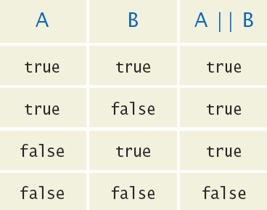
Combined Conditions: ||
Combining two conditions is often used in range checking
Is a value between two other values?
Only one side of the or must be true for the result to be true
if (temp <= 0 || temp >= 100) {
state = "Not Liquid";
}

Slide 43
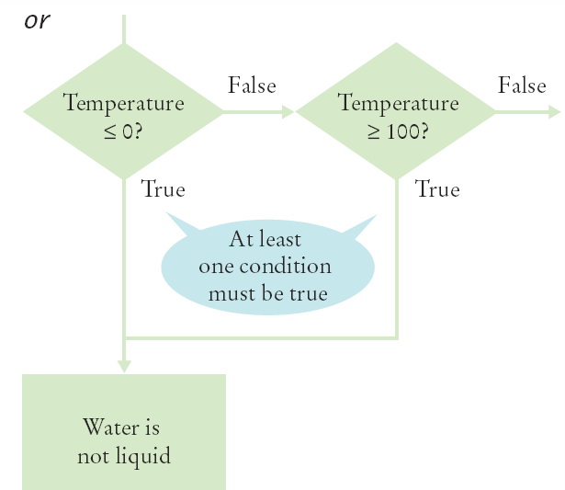
Flowchart Using OR
if (temp <= 0 || temp >= 100) {
state = "Not Liquid";
}

Slide 44
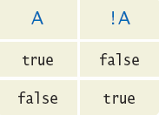
The NOT Operator: !
If you need to invert a boolean variable or comparison, precede it with !
if (!attending || grade < 60) {
action = "Drop Student";
}
if (attending && !(grade < 60)) {
action = "Tutor Student";
}

Slide 45
Lazy Evaluation: ||
Java uses lazy evaluation
Combined conditions are evaluated from left to right
If the left half of an or condition is true, why look further?
Put conditions more likely to be true first
if (GPA > 3.9 || numCredits > 0) {
awardEligible = true;
}

Slide 46
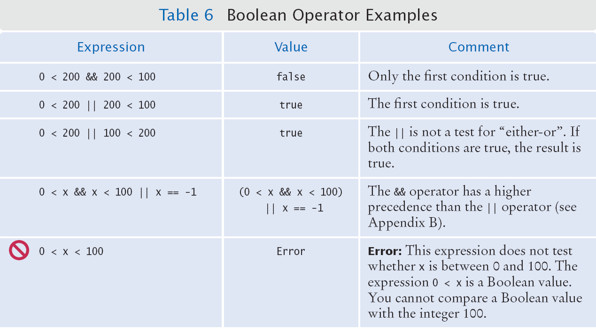
Boolean Operator Examples

Slide 47
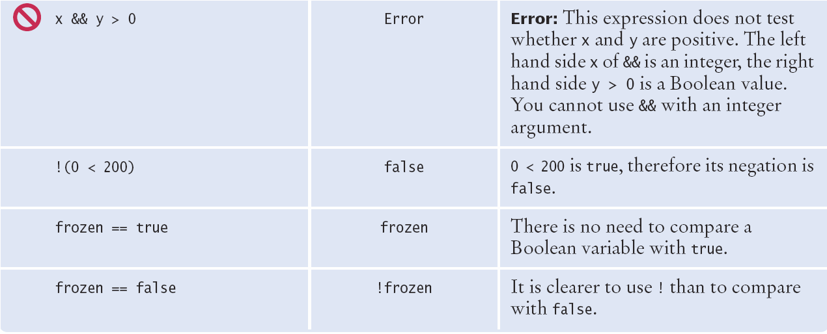
Boolean Operator Examples (Cont'd)

Slide 48
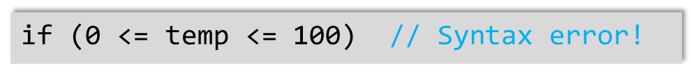
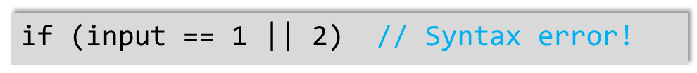
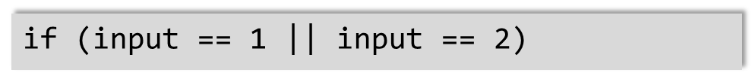
Common Errors
Combining multiple relational operators
Can be used in math, not in Java
Requires two comparisons
Use:
Also bad
Use:
if (temp >= 0 && temp <= 100)

Slide 49
Common Errors (Cont'd)
Confusing && and ||
Surprisingly common error to confuse and and or conditions
A value lies between 0 and 100 if it is at least 0 and at most 100
A value lies outside that range if it is less than 0 or greater than 100
There is no golden rule, you just have to think carefully, and check your pseudocode
Remember Desk Checking!

Slide 50
Input Validation
Accepting user input is dangerous!
Consider the elevator program
The user may input an invalid character or value
It must be an integer
Steps
We can check for an integer
Then range check the value

Slide 51
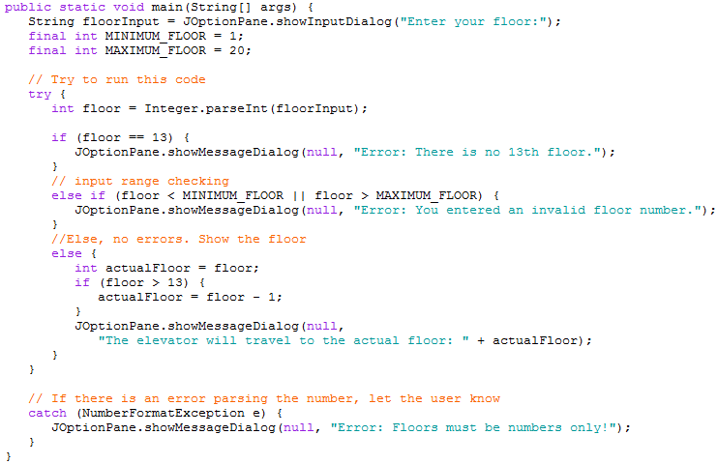
Elevator Simulator Enhanced

Slide 52
Questions?

